Slide 1
LSTM: Updates
Yash Lal

Slide 2
Recap
Vaginal microbiome dataset
Predict dynamics
LSTM approach
Finnicky, inaccurate behavior

Slide 3
Data Structure
Sequence length of 14 (28 / 2)
1 input channel / 1 output channel
No crossing patients
Blanks of length 1 averaged in

Slide 4
NN Structure
LSTM
Linear Layer
Sigmoid to enforce [0,1] ranged output

Slide 5
Training and Hyperparameter
Using Adam optimizer with 0.001 LR, H=25 seems to work well
Trial and error
Following slides show good predictions
Training seems to be relatively independent of H
Large H takes long time
Not good with limited data
Too small of H gives weird outputs

Slide 6
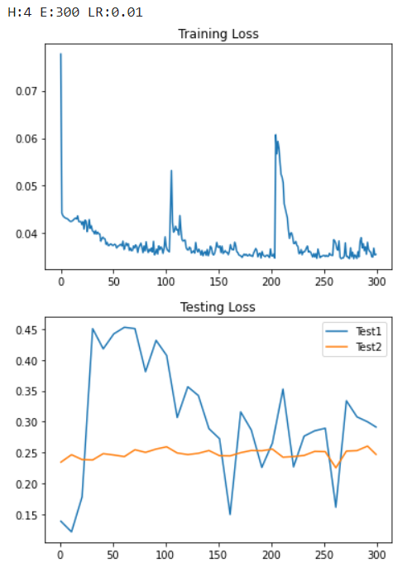
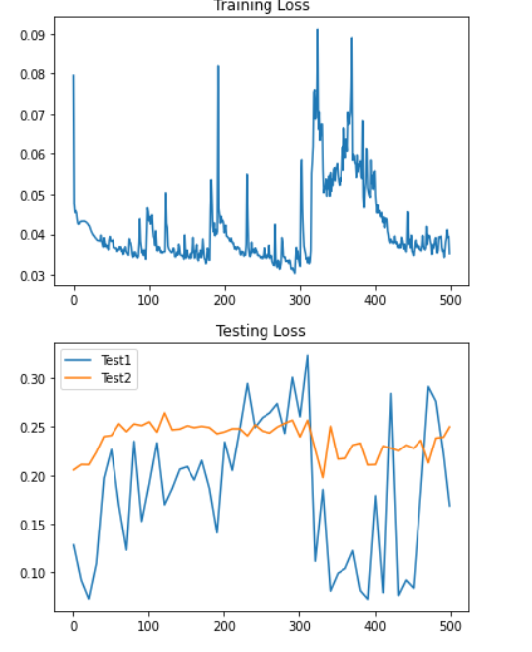
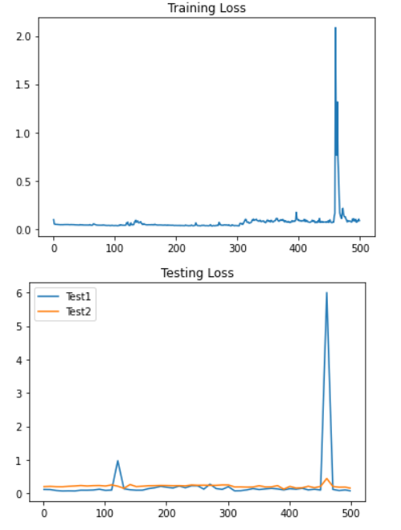
Problems We Fixed
Numerical instability and spikiness in training/testing
H=4,15,25 (LR 0.01)

Slide 7
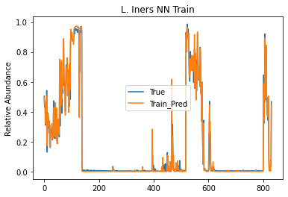
Accurate Testing Prediction
Long View

Slide 8
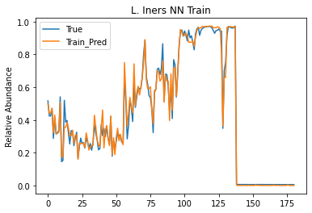
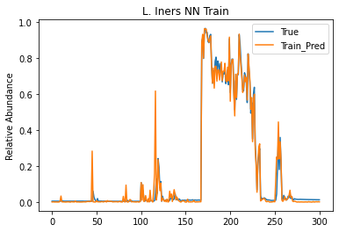
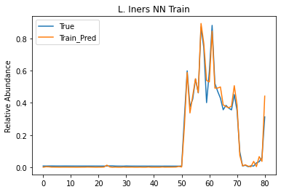
Accurate Testing Prediction: Zooming In
0-180, 350-650, 750-end
500 epochs

Slide 9
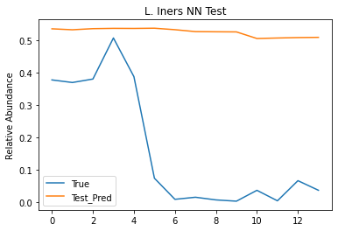
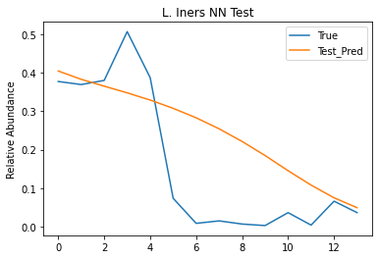
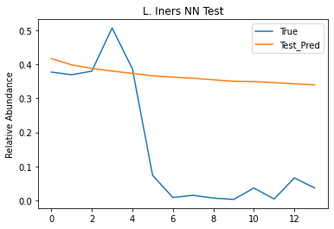
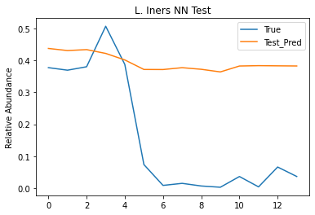
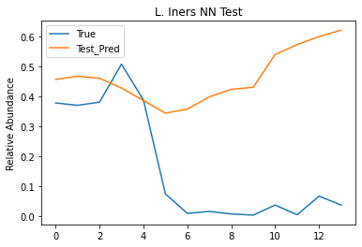
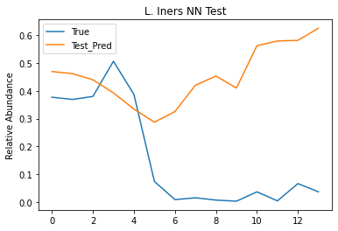
Test 1

Slide 10
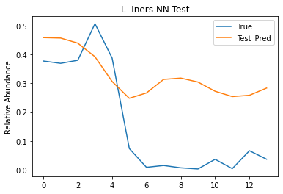
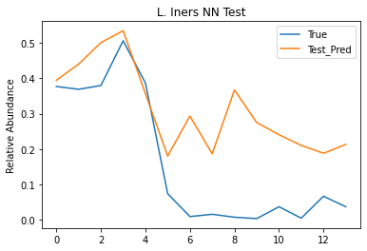
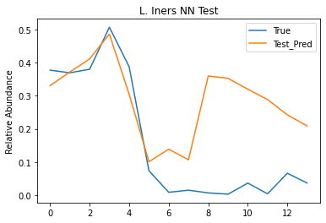
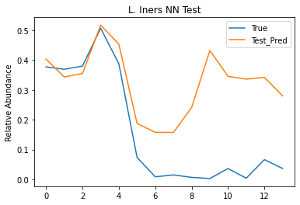
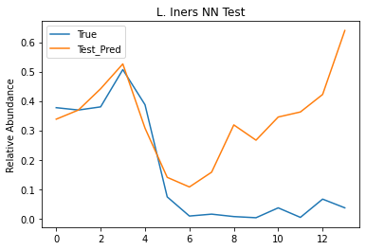
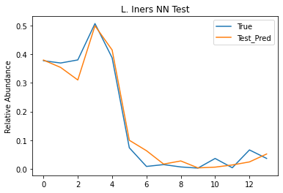
Test 1 (Ct’d)

Slide 11
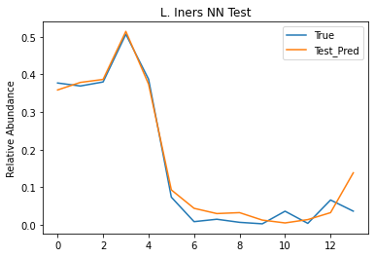
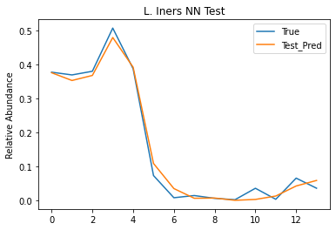
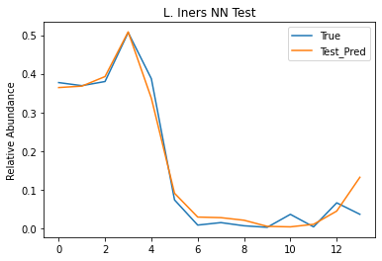
Test 1 (Ct’d)

Slide 12
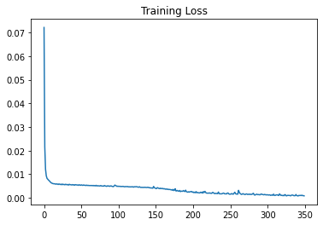
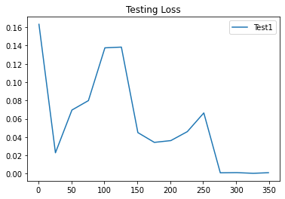
Test 1: Loss

Slide 13
Test 2
Simple trajectory can be misleading
Look at Colab for progression
Loss function?

Slide 14
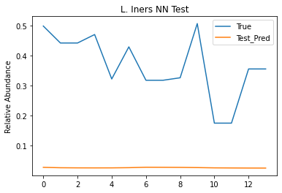
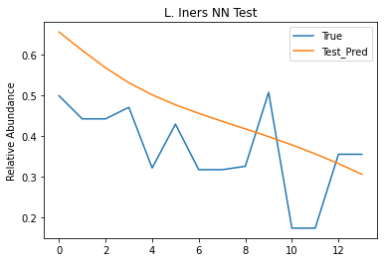
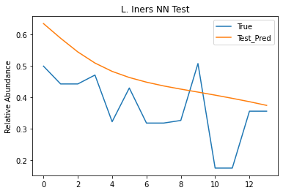
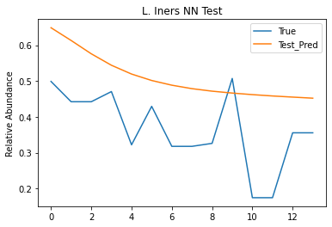
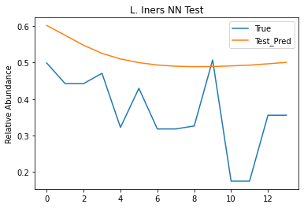
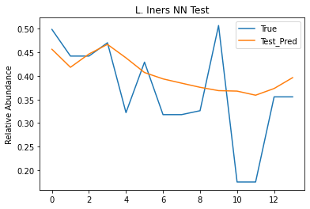
Test 3

Slide 15
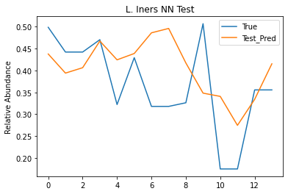
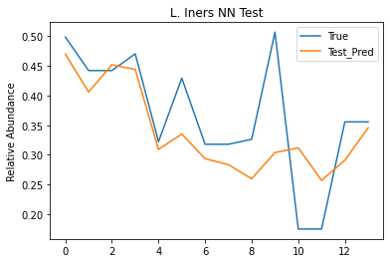
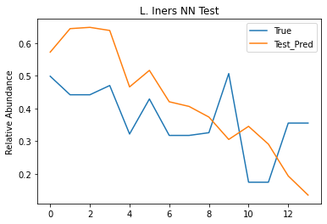
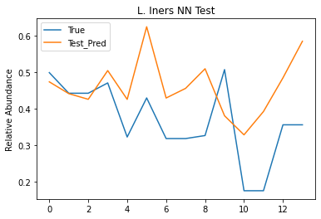
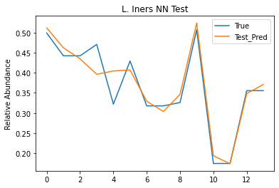
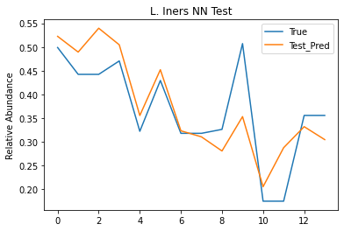
Test 3 (ct’d)

Slide 16
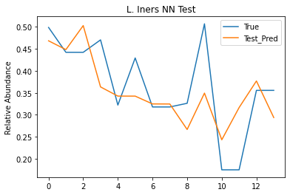
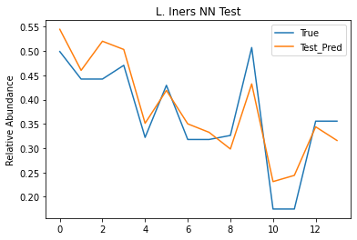
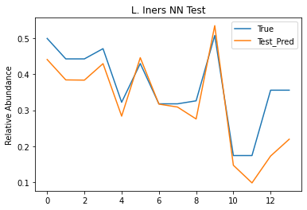
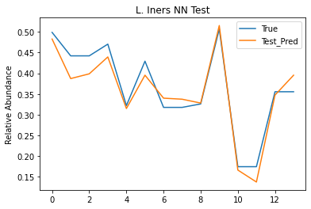
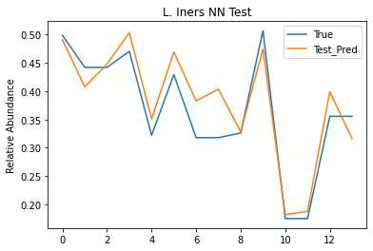

Slide 17
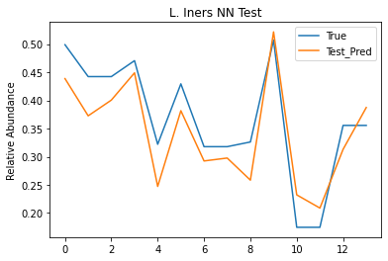
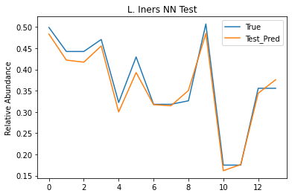
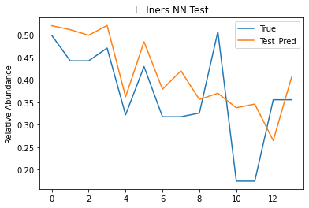

Slide 18
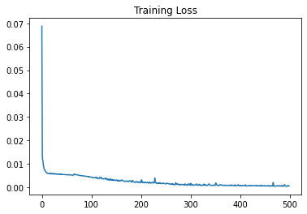
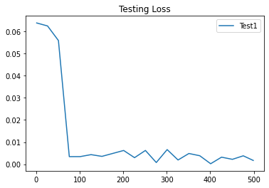

Slide 19
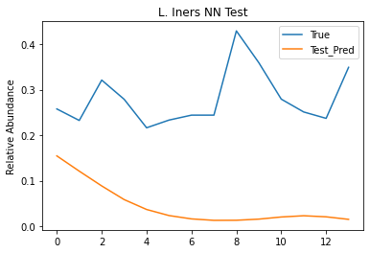
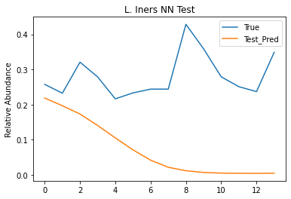
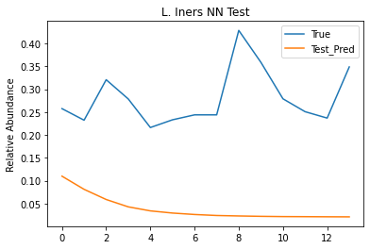
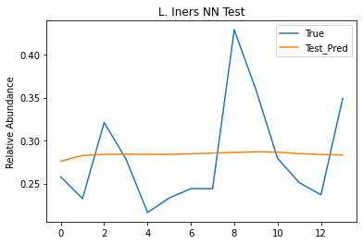


Test 4

Slide 20







Slide 21







Slide 22




Slide 23



Slide 24
Possible Exploration
Batch Normalization
Dropout
Regularization

Slide 25
Questions and Suggestions
How can we get stable, accurate, and generalized predictions from our moments of success?
“Bumps” on testing loss
Swap and switch program

Slide 26
Next Steps
Single channel with other species
Multi-channel
Multi -> one
Multi -> multi
If needed, stacked LSTMs?

Slide 27
Meeting Schedule Going Forward
I put this slide so we don’t forget to set this

